Slide 1




Web Technology
Project
ATM MACHINE

Slide 2

Group Members
Pratay Nandy
2005115
Udit Agarwal
2005556
Sristi
C hakraborty
2005135
Srijan
C hakraborty
2005834

Slide 3

OBJECTIVE
To develop a project using concepts of the JAVA Programming Language

Slide 4
INTRODUCTION
Everyone uses ATM machine on a frequent basis. In this project, we tried to implement the functionalities of the ATM machine in a not-so- fancy character user interface.
Here we will be using the terminal as a way to interact with the program and do the transactio

Slide 5

REQUIREMENTS
Any kind of operating system
Java JDK
Any terminal that can run java

Slide 6
Packages Used - Java AWT
java.text.DecimalFormat
DecimalFormat is a concrete subclass of NumberFormat that formats decimal numbers. It has a variety of features designed to make it possible to parse and format numbers in any locale,
java.util.Iterator
An iterator over a collection. Iterator takes the place of Enumeration in the Java Collections Framework
java.util.HashMap
Hash table based implementation of the Map interface. This implementation provides all of the optional map operations, and permits null values and the null key.
jjava.util.Map
An object that maps keys to values. A map cannot contain duplicate keys; each key can map to at most one value..

Slide 7

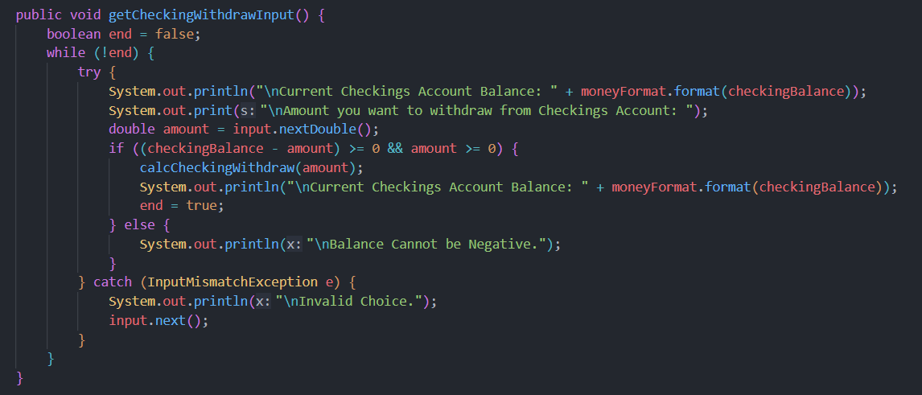

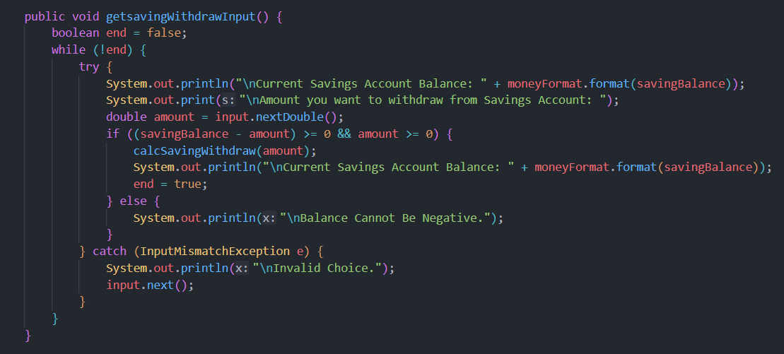

C O D E SNIPPETS

Slide 8
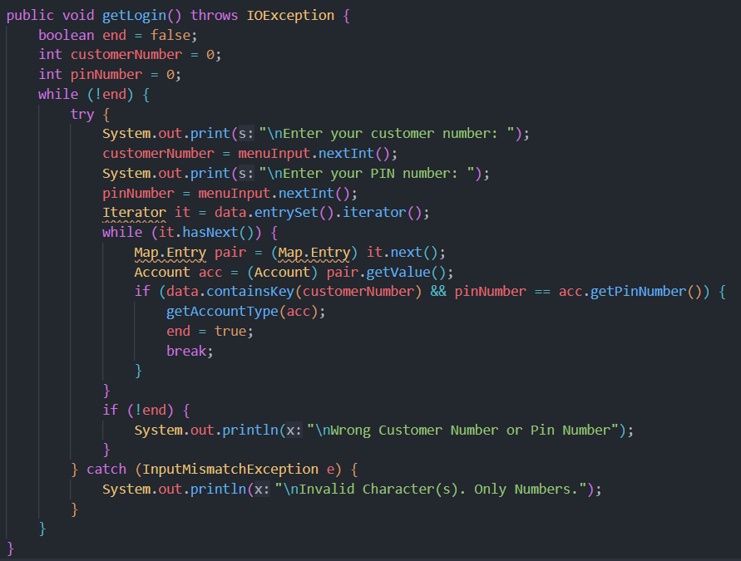
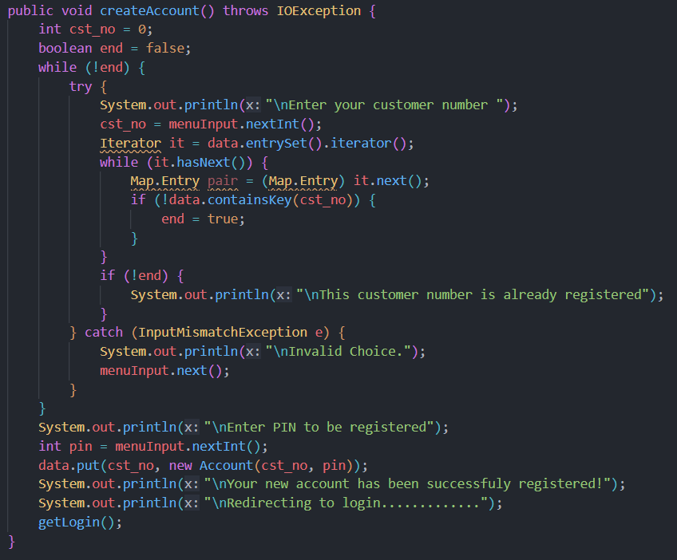

C O D E SNIPPETS

Slide 9
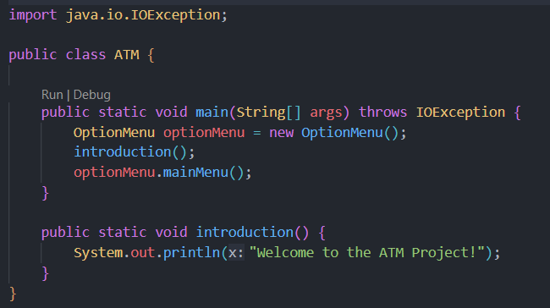
CODE SNIPPETS

Slide 10


LEARNINGS
Real life implementation of
classes and objects.
Learnt HashMaps.
Managing exceptions.

Slide 11
OUTCOMES
We created a CUI-based ATM machine that stores the data locally in hashmaps and retrieves upon
called during runtime.

Slide 12
FUTURE EXTENSIONS
Adding SQL support to store the
data.
Adding a GUI for better user
experience.

Slide 13
THANK YOU

